Slide 1


An Efficient Approach to store data for Location based Chat Application
3rd Phase Demo
By:
Jabiulla Mulla
(01FE15MCS004)
Under Guidance:
Dr. V.P.Baligar
T.B.Dinesh

Slide 2
INDEX
Abstract
Introduction
Objective
Literature Survey
Requirements
Design
Implementation
Testing
Deployment
Conclusion
References

Slide 3
ABSTRACT
Nowadays chat application are replacing the normal SMS so that users are more trending towards the chat application in the android as well as iPhone devices and the usage of the application is becoming higher and the data to be saved is more so we need an efficient way to store those chats in order to retrieve fast ,
In this we provide an efficient way to store those chats in Nosql Database , Non Structured Query Language which is Document type of NoSQL database where data is organized as collections.
The Database used is Cloudant`s CouchDb which has a special feature called Geo Spatial Indexing which is used to access the data based on location of certain radius.
In our application we mainly use HTTP Post request for posting any new document to the database, HTTP put request for updating a document and HTTP GET Request for the design document for retrieving the document to display to the users

Slide 4
Introduction:
The location is very important these days, for every search we do in any website, location becomes an integral part and there are many applications which uses the location. Our application is one such application which is completely based on location.
Every data in our application holds the current location of our phone. The messages, events are all filtered according to the location with certain radius set.
To develop the application it is necessary to store the data in the database such as user details, event details, and offer details, post details of the application, to maintain the data from the external attacks and to send data to the user whenever it is requested with credentials.

Slide 5
Objectives:
The Main objective of the project is to store, retrieve and maintain the data of the application in the Cloudant Database.

Slide 6
Literature Survey:
Quora- It uses MYSQL Database
WatsApp- It uses mnesia, the database of erlang which is NOSQL Database
Twitter- It uses MySQL, FlockDB, Cassandra, HDFS (Hadoop Distributed File System), Mesos , Zipkin
Playo- It uses NOSQL Database
Happn

Slide 7
Difference between SQL & NoSQL
Sr No | SQL |  |  | NOSQL
1 | SQL databases are mainly called as Relational Databases (RDBMS) |  |  | NoSQL database are mainly called as non- relational or distributed database
2 | SQL databases are table based databases. This means that SQL databases represent data in form of tables which consists of n number of rows of data |  |  | NoSQL databases are document based, key-value pairs, graph databases or widecolumn stores. NoSQL databases are the collection of key-value pair, documents, graph databases etc.
3 | SQL databases schema | have | predefined | NoSQL databases have dynamic schema for unstructured data
4 | SQL databases scalable | are | vertically | NoSQL databases are horizontally scalable
5 | SQL databases uses SQL (structured query language ) for defining and manipulating the data, which is very powerful |  |  | In NoSQL database, queries are focused on collection of documents. Sometimes it is also called as UnQL (Unstructured Query Language).
6 | SQL databases are good fit for the complex query intensive environment |  |  | NoSQL databases are not good fit for complex queries
7 | SQL databases are not best fit for hierarchical data storage |  |  | NoSQL database fits better for the hierarchical data storage as it follows the keyvalue pair way of storing. NoSQL database are highly preferred for large data set (i.e for big data).

Slide 8
Difference between SQL & NoSQL
8 | SQL databases are best fit for heavy duty transactional type applications, as it is more stable and promises the atomicity as well as integrity of the data | NoSQL uses for transactions purpose, it is still not comparable and stable enough in high load and for complex transactional applications
9 | SQL databases emphasizes on ACID properties ( Atomicity, Consistency, Isolation and Durability) | the NoSQL database follows the Brewers CAP theorem ( Consistency, Availability and Partition tolerance )
10 | Relational databases were not designed to support Agile software development and be easy scalable | NoSQL databases support Agile software development. Dynamic schema is the key of Agile support in MongoDB.
11 | It’s hard to predict an exact db schema at the beginning of the feature development. If schema is changed in relational database you must think over data migration to the new schema. If data is large it’s a very slow process that involves significant downtime. If data is changed regularly the downtime may also be frequent | NoSQL database in contrast to relational databases doesn’t require a predefined schema and what is more it doesn’t require schema at all. We can call it schema-less database. This feature is fully fit into the Agile approaches.

Slide 9
Requirements:
Functional Requirements:
User data during registration shall be able to store in database
User should get the details of the available groups from the database
User shall be able to see the previous posts from the database
User shall be able to post the new questions, message that should be stored in database
User shall be able to store the replies in the database
User shall be able to see the post data from database in the map
User shall be able to get the data from the database whenever the user requests the design Documents
User shall be able to reply the post such that the post detail is edited from database

Slide 10
Non- Functional Requirements:
Scalability: The application should be highly scalable; around 90% of users must be able to use the application simultaneously.
Performance: The application should be interactive and the delays involved must be less which is less than 2 secs.
Reliability: The application should be reliable on Cloudant service and internet service.
Speed : The application speed should depend on internet service.
Security: The application should have authentication mechanism which should avoid data hacking.
Availability: The application should be available anytime.
Usability : The application is easy to handle and navigate between screens without delays

Slide 11
Hardware Requirements
Operating System: Windows/Linux
RAM: min 4 GB
Hard Disk: min 250 GB
Android Phone

Slide 12
Software Requirements
Ionic Framework
Angular JS
Node.js
NPM
Cloudant Database
ANDROID SDK

Slide 13
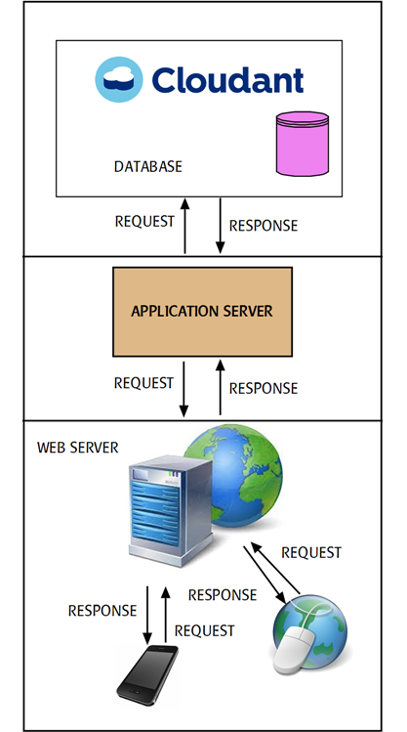
Design
Architecture Design

Slide 14
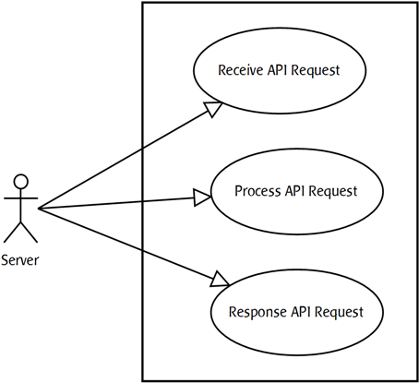
Detailed Design
UseCase Design
Server User Case

Slide 15
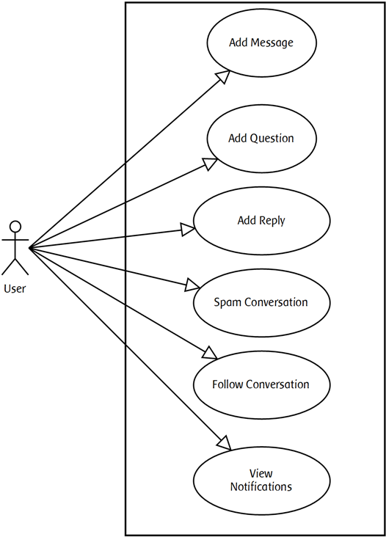
Detailed Design
b) User Use Case

Slide 16
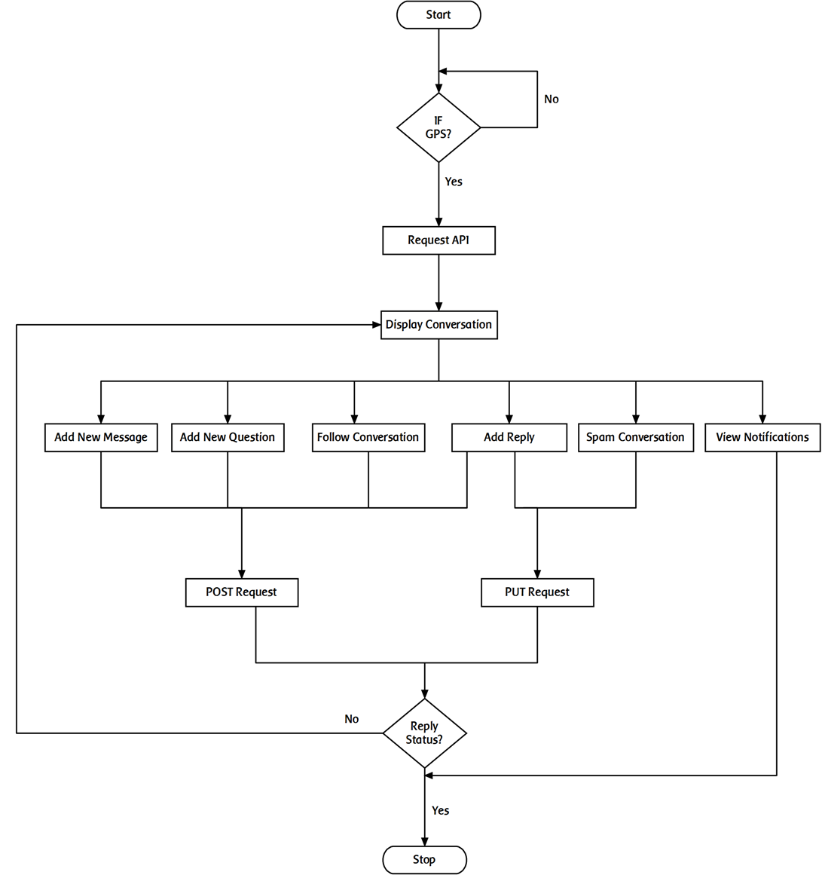
Detailed Design
2.Flowchart

Slide 17
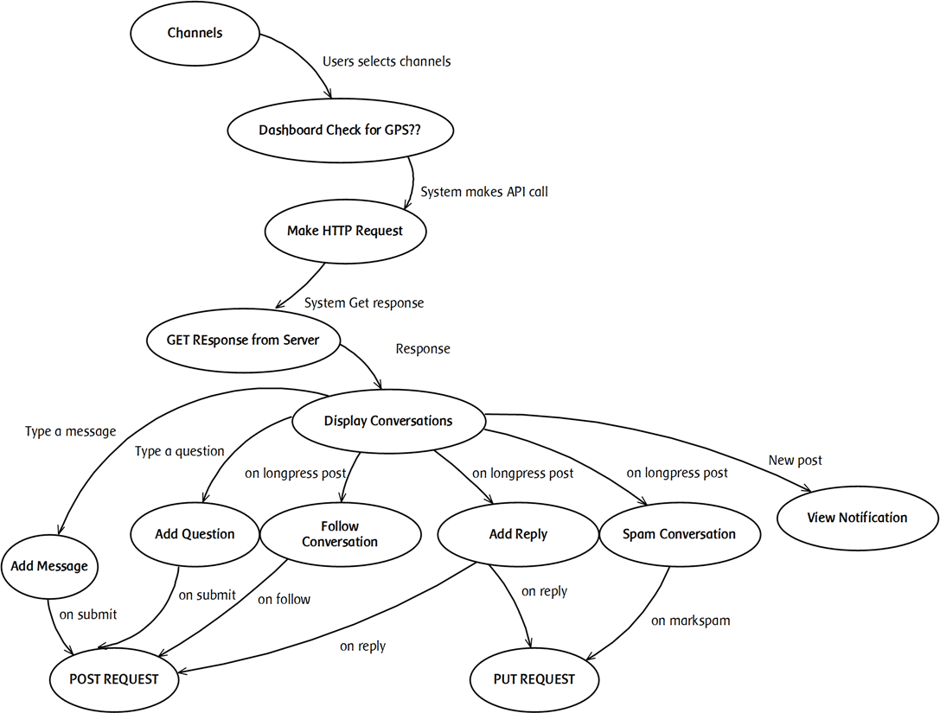
Detailed Design
3) Data Flow Diagram

Slide 18
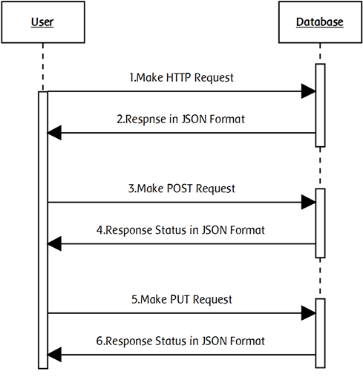
DETAILED DESIGN
Sequence Diagram

Slide 19
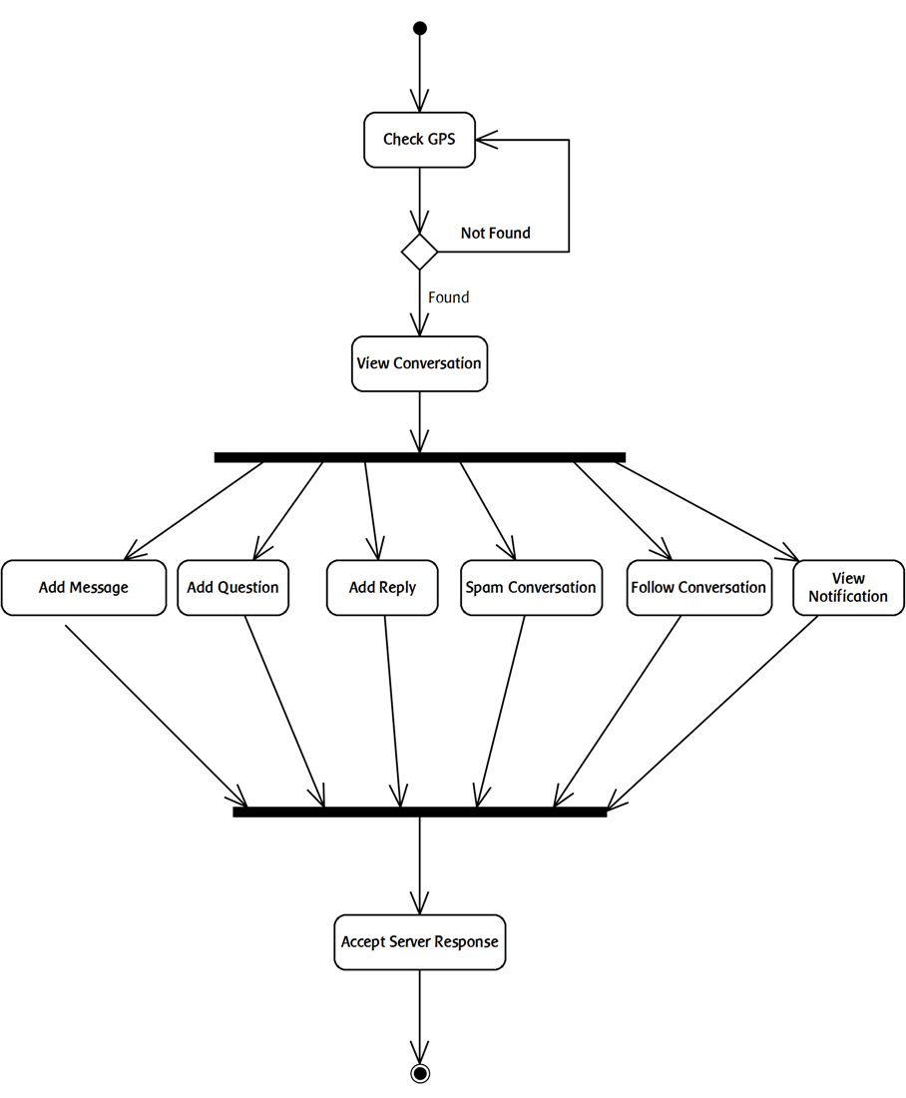
DETAILED DESIGN
Activity Diagram

Slide 20
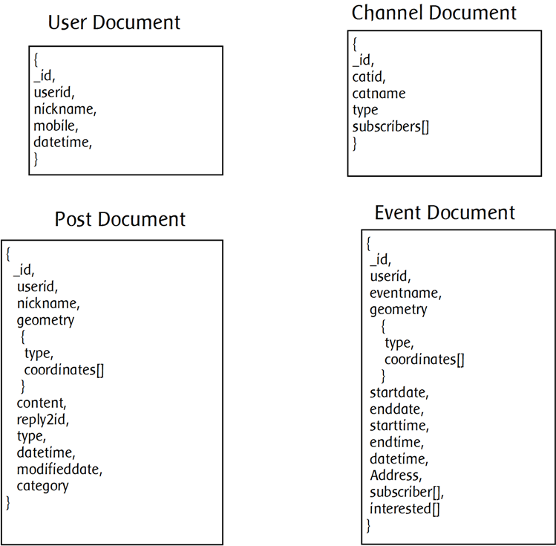
DETAILED DESIGN
Database Collection

Slide 21
IMPLEMENTATION:
Our Application is mainly divided into 5 Main Components
Registration Module
Conversation Module
Events Module
Offers Module
Map Module

Slide 22
IMPLEMENTATION:
Design Documents in Server
To retriew all users
To retriew all channels
To retriew all conversations
To retriew all questions
To retriew all replies
To retriew onfollow conversations

Slide 23
IMPLEMENTATION:
Conversation Component is mainly divided into 9 Modules
Get Location
Add New Question
Add New Message
Reply to a post
View Conversations
View Replies
Follow Particular Post
Spam Particular Post

Slide 24
Testing
Software Testing is an activity in software development. It is an investigation performed against a software to provide information about the quality of the software to stakeholders. Software testing is a process of executing a program or application with the intent of finding the software bugs.
Types Of Testing
Unit Testing
Component testing
Integration testing
System testing

Slide 25
Unit TESTING
Sl.no. | Description | Priority | Test Condition | Expected Output | Actual Output | Result
1 | Server should always be accepting the request | H | Once the request is been sent server should accept it | Server Excepting Request | Server Excepting Request | PASS
2 | Verify the Mobile has GPS | M | Mobile should be having GPS Device | System can access Location Values | System can access Location Values | PASS
3 | Verify the Mobile connected to the network | M | Mobile should be connected to the internet | Request to be sent | Request to be sent | PASS

Slide 26
COMPONENT TESTING
Sl.no. | Description | Priority | Test Condition | Expected Output | Actual Output | Result
1 | System should send data as object and make POST request to server with credentials | H | Server should accept the request and create a new document in database | New data to be saved in the database | New data to be saved in the database | PASS
2 | System should request for particular view and get response and display to user | H | Server should accept the request and response data as JSON | JSON objects containing POSTS details | JSON objects containing POSTS details | PASS
3 | System should display build number and version code | M | System should display build number and version code | Version Number and Version Code | Version Number and Version Code | PASS

Slide 27
INTEGRATION TESTING
Sl.no. | Description | Priority | Test Condition | Expected Output | Actual Output | Result
1 | Displaying Posts after redirecting from Category View | H | Displaying Posts after redirecting from Category View | User should be able to view Conversation list | User should be able to view Conversation list | PASS
2 | Displaying Follow, Reply, Spam button when user presses on Long Press | H | Displaying Follow ,Reply ,Spam when user presses on Long Press | User should be able to view Follow button and Reply button | User should be able to view Follow button and Reply button | PASS
3 | Enabling Question button, Message when user types in the text area | H | Displaying Question button, Message when user types in the text area | User should be able to view Question button and Message button | User should be able to view Question button and Message button | PASS

Slide 28
System testing
Sl.no. | Description | Priority | Test Condition | Expected Output | Actual Output | Result
1 | Making sure Server Cloudant is running and accepting the request | H | Making sure IBM Cloudant server running and receiving the request | POST and GET request should be accepted and sends JSON as response | POST and GET request should be accepted and sends JSON as response | PASS
2 | Mobile not connected to Internet | M | Mobile cannot make HTTP request to Server | Connection Fails | Connection Fails | FAIL
3 | Response time for HTTP Request to be processed | H | Request should be sent and processed as early as possible | Should take less than a minute | Takes more than a minute when server is busy | FAIL

Slide 29
System testing
Sl.no. | Description | Priority | Test Condition | Expected Output | Actual Output | Result
4 | User should be able to navigate from Category Layout to Conversation Layout easily | H | User should be easily navigated without any delay | User redirected should take less than a second | User redirected should take less than a second | PASS
5 | User can add new message, new question, reply to question if Location is available | H | User can able to post data to the server | If Location is unavailable the user unable to post data to server | If Location is unavailable the user unable to post data to server | PASS

Slide 30
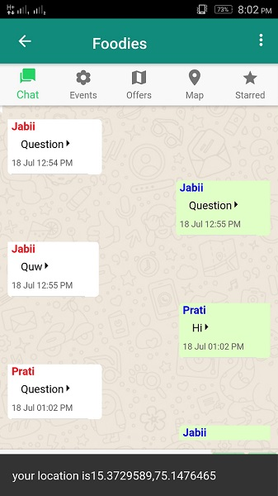
DEPLOYMENT
Get Location

Slide 31
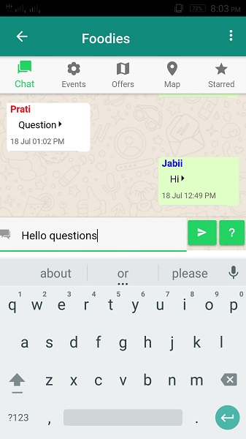
DEPLOYMENT
Add Question
Add Message

Slide 32
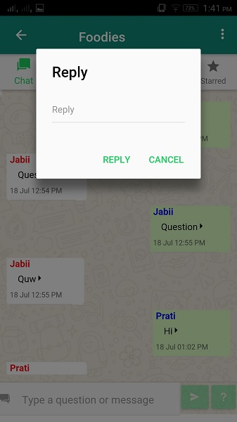
DEPLOYMENT
Add Reply

Slide 33
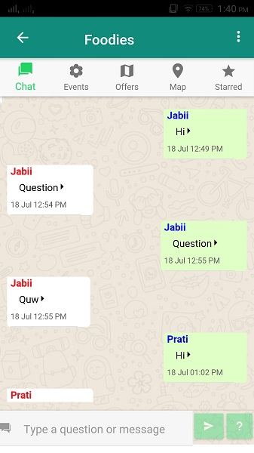
DEPLOYMENT
View Conversations

Slide 34
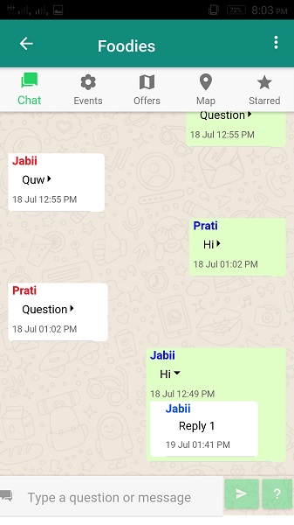
DEPLOYMENT
View Replies

Slide 35
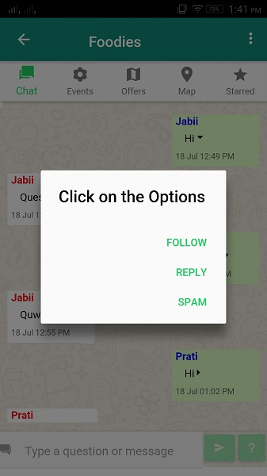
DEPLOYMENT
Follow particular Post
Spam particular Post

Slide 36
Conclusion
By the Requirement Gathering, Analysis and Designing Phase of the Location Based Chat Application we concluded that NoSQL Database is required to store the Data of the Application as it is Social Application the data is Big Data.
IBM Product Bluemix is Used to store database as it provides Geospatial Indexing to retriew posts based on radius specified by user.

Slide 37
REFERENCES
[1] Clarence J M Tauro et.al.”Comparative Study of the New Generation, Agile, Scalable, High Performance NOSQL Databases”, IJCA June 2012
[2] http://www.3pillarglobal.com/insights/just-say-yes-to-nosql
[3] Haihong, E. ; Guan Le ; Jian Du”Survey on NoSQL database”, IEEE Conference, Oct 2011.
[4] Yishan Li , Manoharan, S. “A performance comparison of SQL and NoSQL databases “, IEEE conference, Aug 2013.
[5] Radulescu, F. ; Agapin, L.I. et.al. “MongoDB vs Oracle -- Database Comparison “ IEEE Conference, Sept 2012
[6]http://www.thegeekstuff.com/2014/01/sql-vs-nosql-db/

Slide 38


